Slide 1
Predicting network load with machine learning for VNF placement
Proposal for a masters thesis Christoph Kaiser
24.06.2019

Slide 2
Problem description & Motivation
Virtual Network Functions
Placement and scaling algorithms
Create new VNFs if needed
Distribute VNFs in the physical network
A problem of these algorithms is that they can be reactive (e.g. [Dräxler et.al. 2018])
Scaling and placement start too late
If VNF is not already running, startup time is added to processing time
Processing time up to tens of seconds [Mijumbi et.al. 2017]

Slide 3
Possible Solutions
Naive approach: start all VNFs on all nodes
Defeats purpose of VNFs
Waste of resources
VNFs interfere with each other
Instead use machine learning models to predict traffic
Can compensate for startup times
Shut down VNFs earlier
Keep VNFs running

Slide 4
Data
Multiple sources of traces exist
For example from Google and Facebook
Download an analyze
Many GB up to TB of data
Data must be modified
Add service chain
Determine realistic chain
Network structure most likely not part of data
Reconstruction of network from traces not possible
Remove unneeded data
Data will be prepared with R or Python
Also possible to generate traces

Slide 5
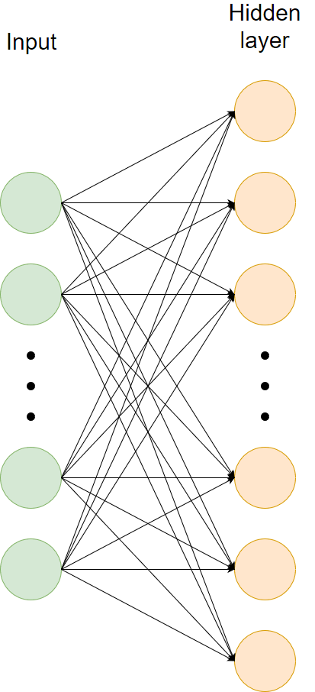
Models
What library to choose
Tensorflow or Keras
Machine learning models
LSTMs
Neural Network
Modelling the input data
No standard way of modelling the input data
Input data can only have limited size
Number of inputs is static
Statistical models
ARIMA

Slide 6
Models
How should the predictions look like
Time
Point in time
e.g. traffic in 10s
Range of time
e.g. traffic in 5s for the next 10s
The load of services
A list of services
Just one service
Prediction for the whole network or just one node

Slide 7
Training
Splitting data for training and testing
Split data in three sets
Training, validation, testing
Usual way of training neural networks
How much data needed for training is not clear
Maybe consider training at runtime

Slide 8
Testing
Gather test data and evaluate
Also using R or Python
Many different evaluations possible
Comparison between point and range prediction
How far into the future do the predictions keep its quality

Slide 9
Summary – major tasks
Gather, sort and modify data
Model inputs
Model outputs
Build models
Training and testing

Slide 10
Structure of the thesis
Introduction
Related Work & Fundamentals
Gathering Data
Download and analyze
Preparing the data
Model Building
Choosing a library
Modeling the input data
Building the models
Training and testing
Training the models
Evaluating the test data

Slide 11
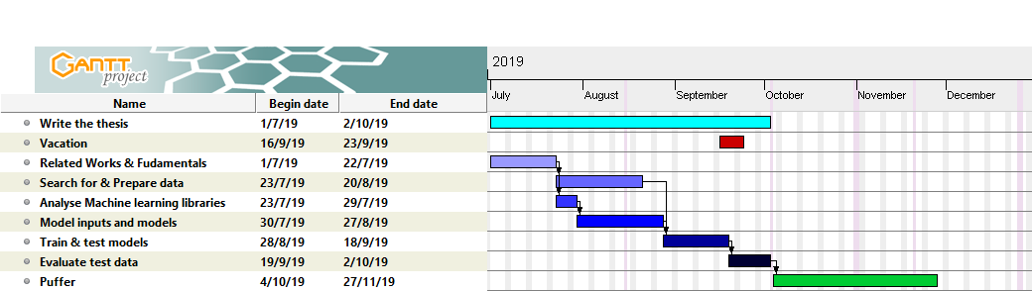
Timetable

Slide 12
Questions?

Slide 13
References
R. Mijumbi, S. Hasija, S. Davy, A. Davy, B. Jennings, and R. Boutaba. Topologyaware prediction of virtual network function resource requirements. IEEE Transactions on Network and Service Management, 14(1):106-120, March 2017.
S. Dräxler, S. Schneider, and H. Karl. Scaling and placing bidirectional services with stateful virtual and physical network functions. In 2018 4th IEEE Conference on Network Softwarization and Workshops (NetSoft), pages 123-131, June 2018.

